Slide 1
Spesification
Collaborated BY mohamed Laaribi

Slide 2
Introduction
E-Bank is a banking service solution that includes all client services available through the web, it helps in gaining time by managing & interacting with online bank services from anywhere & anytime.

Slide 3
Features
E-Bank is a solution for costumers who want to interact with their accounts via the World Wide Web,
It gives the costumers insights about the bank new offers (news),
It has a fast signin up with digitilazed process (form),
E-Bank privide a fully rich up to date currency change

Slide 4
Features
A client can sign in & out through any connected device (responce media querry),
A client can transfer money to any collaborated bank,
Client data are stored in a local database by the property (localStorage.setItem, localStorage.getItem),
E-Bank solution respects data confidentiality by mzking pzsswords invisible( input:password)

Slide 5
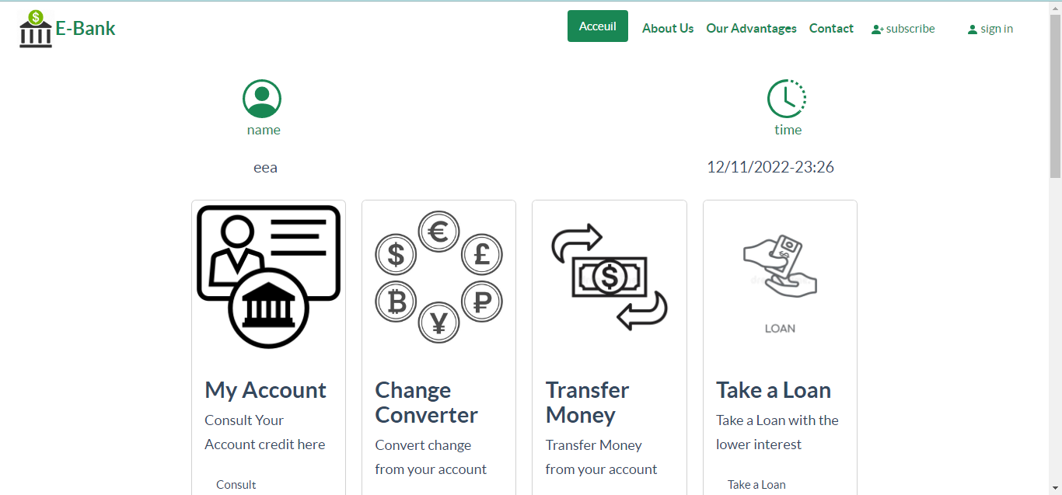
responsivety

Slide 6
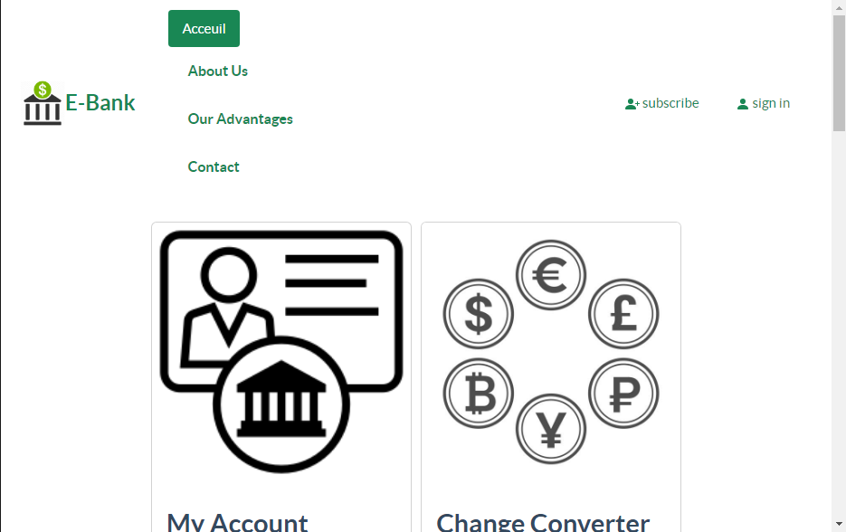

Slide 7
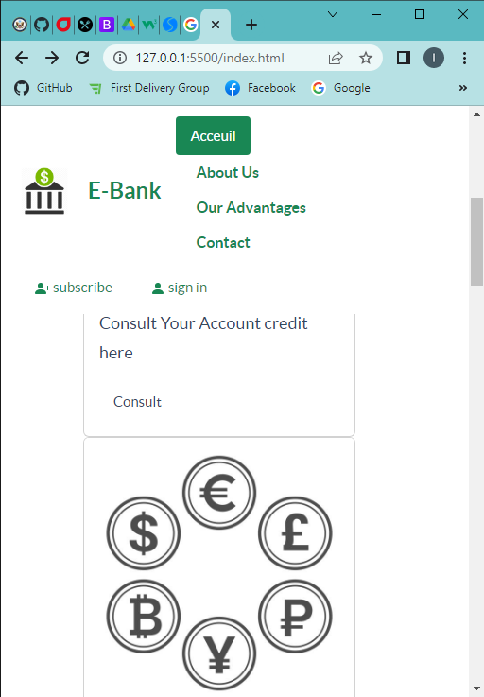

Slide 8
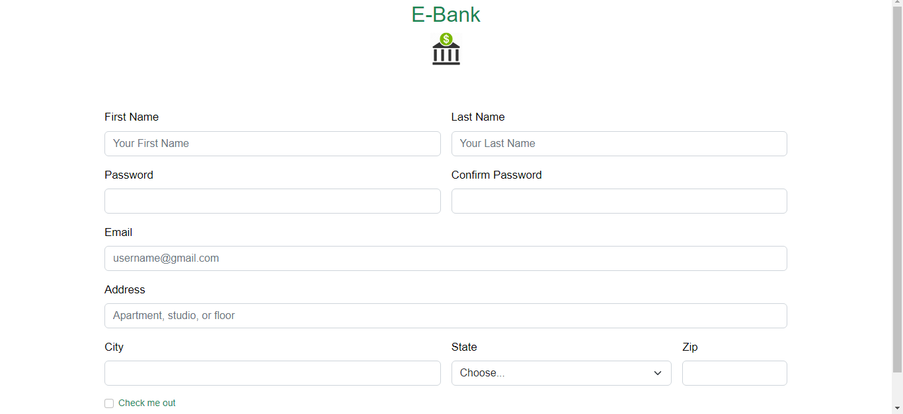

Slide 9
